Slide 1
Literature Review
Article Title: The effect of the Internet on international trade Authors : Caroline L. Freund and Diana Weinhold Published: Journal of International Economics 62 (2004) 171-189 Link: www.elsevier.com/econbase

Slide 2
Outline
Objective of the Paper
Literature Review
Gaps
Opinion
Conclusion

Slide 3
Objective of the paper
The objectives of this paper were;
To explore how Internet technology adoption and integration influences international trade patterns and volumes.
To assess various aspects such as the reduction in trade costs, the impact on small and medium enterprises, changes in consumer behavior, and the overall economic effects of globalization driven by digital communication and e-commerce platforms

Slide 4
Literature Review
No. Sr. | Authors | Titles | Emphasis | Findings
1. | Sanders (2000) | E-commerce and International Trade: The Impact of the Internet on Global Business | He focuses on the rise of e-commerce and its impact on global trade. | The study estimates that global e-commerce cross-border trade was $44 billion in 2000, projected to grow to $1.4 trillion by 2004, accounting for 18 percent of total exports. Highlights specific examples of industries and companies that have benefited from the Internet's ability to facilitate international trade.
2. | Baldwin (1988) | Hysteresis in Import Prices: An Empirical Analysi | Baldwin's seminal work emphasizes the importance of fixed entry costs in international trade. | Introduces the concept of hysteresis in import prices, where fixed costs play a crucial role in determining trade flows. Suggests that sunk costs can explain the persistence of trade patterns and market entry behaviours.
3. | Eichengreen and Irwin (1998)) | The Role of History in Bilateral Trade Flows | This study explores the historical persistence of trade patterns and the role of fixed costs. | Finds that historical trade relationships significantly influence current trade patterns, which the authors interpret as evidence of high entry costs. Emphasizes the long-lasting impact of initial trade connections on future trade volumes.

Slide 5
Literature Review
No. Sr. | Authors | Title | Emphasis | Findings
4. | Roberts and Tybout (1997) | The Decision to Export in Colombia: An Empirical Model of Entry with Sunk Costs | They investigate the role of fixed entry costs at the firm level. | Using firm-level data, the study shows that sunk entry costs are significant determinants of export behaviors among Colombian firms. Firms with lower entry costs are more likely to engage in export activities, highlighting the barrier that high fixed costs represent.
5. | Freund (2000) | Different Paths to Free Trade: The Gains from Regionalism | He examines the persistence of trade links within the European Union. | Finds that trade links between original EU members are highly persistent over time. Hypothesizes that fixed entry costs contribute to this persistence, maintaining long-standing trade relationships.
6. | Rauch (1996) | Networks Versus Markets in International Trad | He focus on the role of networks and information in reducing trade costs and expanding markets. | Develops a search theory of trade where networks, such as family ties and business groups, help reduce entry costs and expand export markets. Networks are shown to play a critical role in overcoming information barriers in international trade.

Slide 6
Literature Review
No. Sr. | Authors | Title | Emphasis | Findings
7. | Rauch (1999) | Joint Ventures: Theoretical and Empirical Perspectives | He focus on the role of networks and information in reducing trade costs and expanding markets. | Further explores the importance of networks and market familiarity, such as common language and colonial ties, in establishing trade links. Demonstrates that networks are particularly crucial for goods that do not trade on organized exchanges or have reference prices.
8. | Goldberg and Knetter (1997) | Determinants of Export Orientation of Foreign Production by U.S. Multinationals: An Inter-Country Analysis | They investigate the relationship between exchange rates and goods prices in international trade. | Highlight the importance of pricing-to-market behavior by firms, indicating that imperfect competition and market segmentation are significant factors in trade. Firms adjust their prices in response to exchange rate changes, reflecting strategic behavior in international markets.

Slide 7
Methodology
The authors of this section detailed the analytical framework and the empirical methods used to examine the relationship between Internet growth and trade growth.
The methodology described the use of a model with imperfect competition and fixed costs of entry into a foreign market.
The authors explained how the Internet, by lowering these market-specific fixed entry costs, can lead to increased trade.
This part also elaborated on the construction of a theoretical model that predicts how Internet connectivity affects trade flows, incorporating elements like the number of firms, market size, and distance

Slide 8
Data
Here, the authors described the types of data utilized in the analysis. This includes the use of bilateral trade data, data on Internet hosts from the Internet Software Consortium, GDP, population, geographic distances, common linguistic heritage, and colonial links, among other variables. In this section the authors discussed the sources of these data, the rationale for their selection, and any limitations or potential biases in these data sources.
Data Analysis Model
In this part, the authors outlined the econometric models used, such as panel data regressions and gravity model estimations. They detailed how these models are used to parse out the effects of Internet proliferation on trade, adjusting for other factors like GDP growth, distance, and economic ties.

Slide 9
DATA SOURCE AND MEASUREMENT
Internet Development Data:
The study uses data from the Internet Software Consortium (ISC) on the number of web hosts attributed to each country. This data measures the Internet's spread by counting top-level domain names. The domains considered are ISO country codes, alongside generic domains like .com, .org, .net, etc. The measure, called "HOST," reflects relative Internet development in each country.
Bilateral Trade Data:
Data on bilateral merchandise trade flows, GDP, and population are sourced from the International Monetary Fund (IMF). Geographic distances between countries are obtained from a study by Shang-Jin Wei, who compiled data from "Direct-Line Distances" (1986). Data on common linguistic heritage and colonial links are from the Rand McNally Historical Atlas of the World (1994), while free trade area data is from the World Trade Organization (WTO).
Countries Included:
The study includes data from 56 countries, with Internet development and trade data spanning from 1995 to 1999.

Slide 10
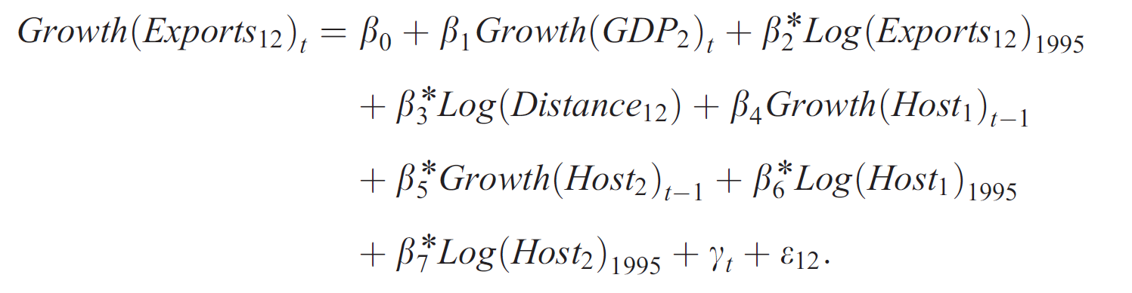
METHODOLOGY
Key Variables:
HOST: Represents the number of Internet hosts and serves as a proxy for Internet development.
Growth of GDP: Measures economic growth in the importing country.
Distance: Geographical distance between trading countries.
Control Variables: Include population, real exchange rates, and initial trade levels.

Slide 11
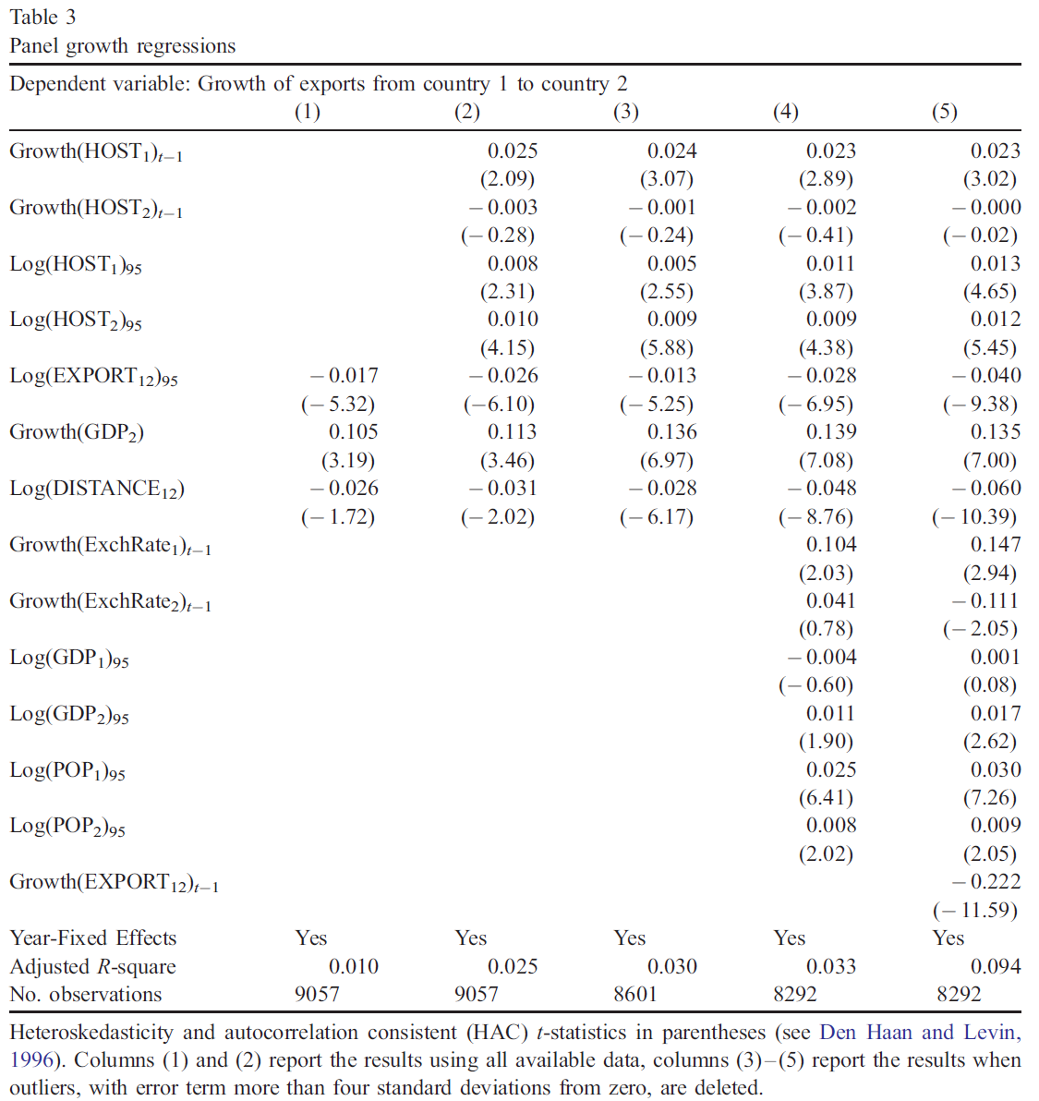

Slide 12
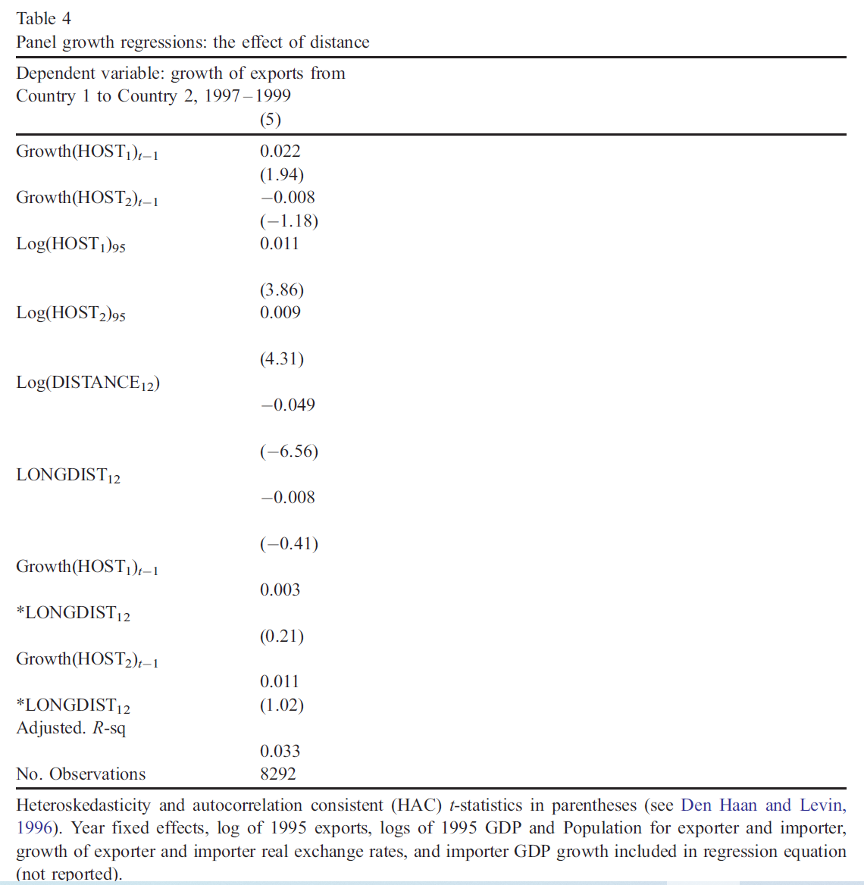

Slide 13
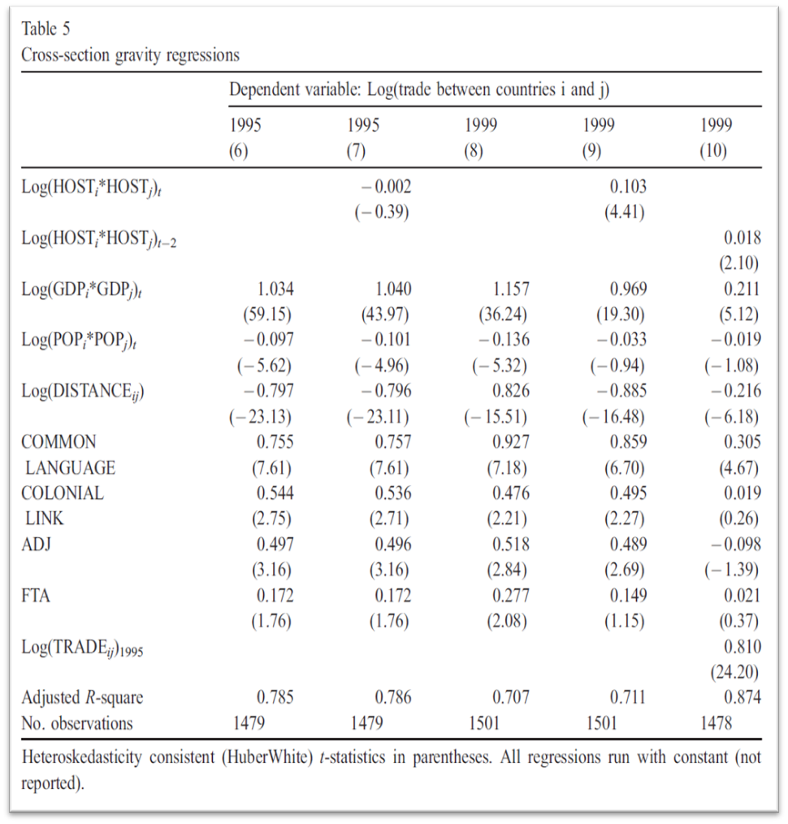

Slide 14
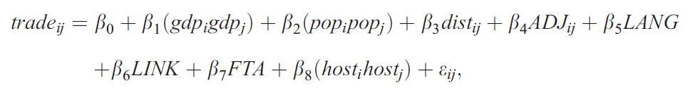
Key Variables:
ADJ: Represents the dummy variable for adjacent countries
LANG: A dummy for countries that speak the same language.
FTA: A dummy for countries that are part of a free trade agreement.

Slide 15
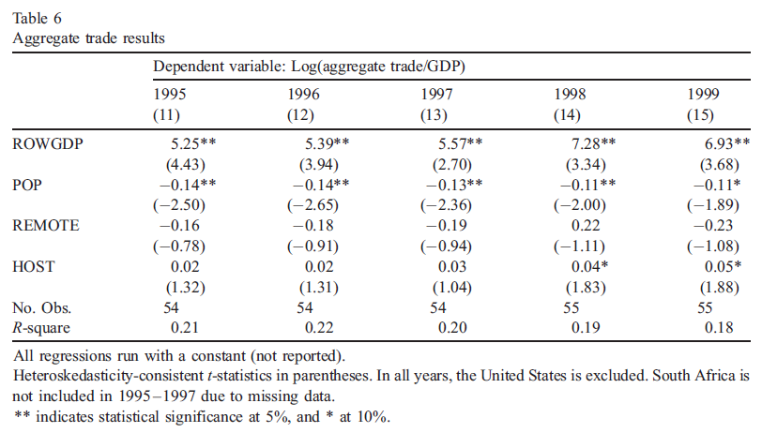

Slide 16
Empirical Estimation Strategy
On the empirical estimation strategy, the authors provided a comprehensive overview of the regression analysis performed, including the decision to use panel data analysis to control for unobserved heterogeneity and the rationale for the selection of specific independent variables. They also justified the use of certain interaction terms, lagged variables, and control variables in the regressions.
Results
In this section the authors presented the findings from the empirical analysis, highlighting the key effects of Internet growth on trade growth. They discussed the significance of the results, the robustness checks performed, and how these findings aligned with existing literature. Charts and tables summarizing the regression outputs were included to provide clear, visual representations of the findings.

Slide 17
Opinion on the Literature
The literature review in Freund and Weinhold's paper is comprehensive and well-integrated, providing a solid foundation for their investigation into the Internet's impact on international trade. It effectively highlights the role of fixed entry costs, the importance of networks, and the early influence of the Internet on trade dynamics. However, the identified gaps suggest several areas for further research:
Modern Digital Economy:
As the digital economy has evolved significantly since the late 1990s, updating the literature to include more recent studies would provide a clearer picture of the current impact of the Internet on trade.

Slide 18
Services Trade: Given the rise of digital services, more research focused on how the Internet affects trade in services is essential. This could include studies on e-commerce platforms, digital marketing, and remote service delivery.
Detailed Internet Metrics: Utilizing more detailed and nuanced measures of Internet development would enhance the understanding of its impact on trade. This includes factors like Internet speed, access quality, and usage patterns.
Addressing the Digital Divide: Exploring how differences in Internet access and quality affect trade can inform policies aimed at reducing inequality and ensuring that the benefits of digital trade are widely shared.
Sector-Specific Impacts: Analyzing the impact of the Internet on specific sectors and SMEs can provide more targeted insights, helping to develop sector-specific strategies to enhance trade.
Regulatory Environment: Understanding how different regulatory frameworks impact digital trade is crucial for creating supportive policies that maximize the benefits of the Internet for international trade.

Slide 19
Identified Gaps
Focus on Early Digital Developments
Observation: Literature primarily examines the early stages of e-commerce and Internet growth.
Gap: Limited research on long-term impacts and the evolution of digital trade post-2000s.
Limited Scope on Services Trade
Observation: Existing studies focus on goods trade.
Gap: Insufficient analysis of the Internet's influence on the growing services sector.
Lack of Detailed Analysis on Internet Quality
Observation: Studies use broad measures like the number of web hosts or users.
Gap: Need for specific metrics, such as broadband penetration and digital infrastructure quality, to better understand the Internet's impact on trade.
Digital Divide and Inequality
Observation: Minimal exploration of disparities in Internet access.
Gap: Lack of analysis on how the digital divide affects global trade dynamics and the importance of inclusive policies.

Slide 20
Impact on SMEs and Specific Sectors
Observation: General impact on reducing entry costs discussed.
Gap: Limited insights into the specific effects on small and medium-sized enterprises (SMEs) and various industry sectors.
Regulatory and Policy Factors
Observation: Regulatory environments' role in digital trade is underexplored.
Gap: Need for comprehensive study on how varying Internet regulations across countries impact trade effectiveness.

Slide 21
Conclusion
The literature review in Freund and Weinhold's paper effectively integrates key studies that emphasize the role of fixed entry costs, networks, and information in international trade. These studies collectively highlight the importance of reducing entry costs to facilitate market entry and trade growth. It lays a strong foundation, addressing these gaps through future research will provide a more comprehensive understanding of the Internet's role in international trade. This will help policymakers and business men better navigate the digital landscape and leverage its potential for economic growth.

Slide 22
THANK YOU

Slide 23
In my research, I tried to select 2 styles of citations depending on the major.
APA, American Psychology Association (APA) ensures that the author will never be accused of plagiarism and allows others who read the article to understand where the person obtained their information. Second, APA style provides style and writing guidelines to ensure that the research paper is easy to read and contains all the necessary elements.
What is the advantage of APA?
APA style provides a standard, consistent system for giving credit to others for their ideas. Following these guidelines will help you to avoid plagiarism in your writing. APA Style is widely accepted and is commonly used in professional publications

Slide 24
What is IEEE Style?
The Institute for Electrical and Electronics Engineers (IEEE) is a professional organization supporting many branches of engineering, computer science, and information technology. In addition to publishing journals, magazines, and conference proceedings, IEEE also makes many standards for a wide variety of industries.
IEEE citation style includes in-text citations, numbered in square brackets, which refer to the full citation listed in the reference list at the end of the paper. The reference list is organized numerically, not alphabetically. For examples, see the IEEE Editorial Style Manual

Slide 25
Cont
IEEE Citation Guidelines
IEEE's publication on citation standards covers books, conference technical articles, online sources, periodicals, theses, and more.
IEEE Editorial Style Manual
This style manual provides editorial guidance for IEEE Transactions, Journals, and Letters. It outlines how to divide the parts of a paper, cite figures and tables, and give guidelines for specific grammar rules.
IEEE Article Templates
This site gives the nitty-gritty details on how to edit, format, and submit a paper for IEEE review and publication.

